Slide 1






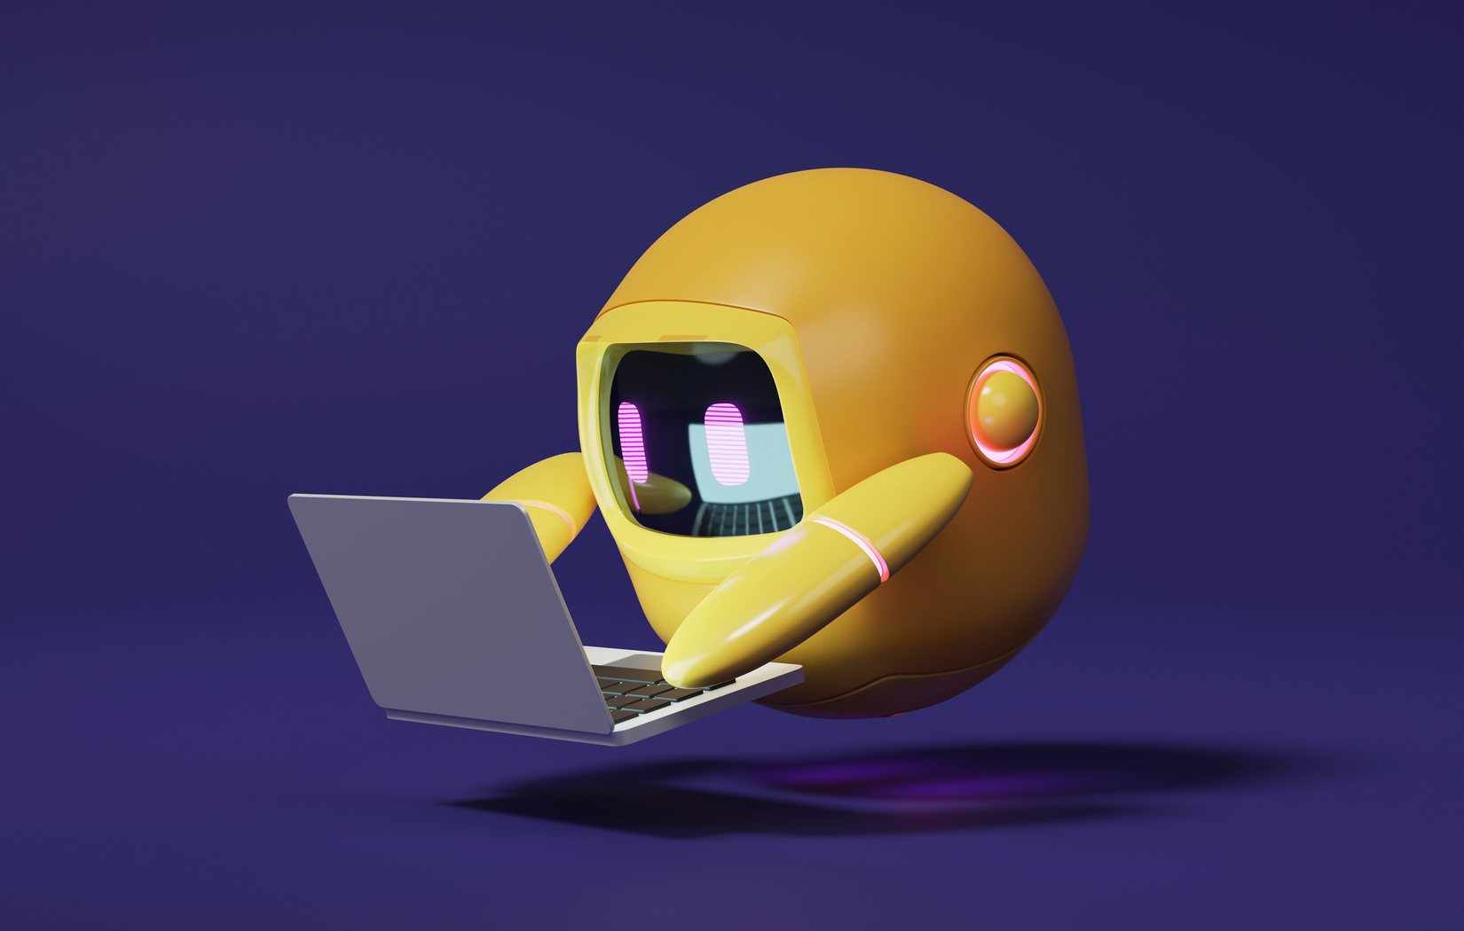

A 2-days National Level Hackathon on
AI in education
Ai for career guidance & future planning
Team FUTURE VISION
[ ASPIRE AI ]
NEERAJ VERMA
SISTEC
www.samadhan.sistec.ac.in/
📂https://github.com/neeraj-verma24/samadhan-2.0.git

Slide 2

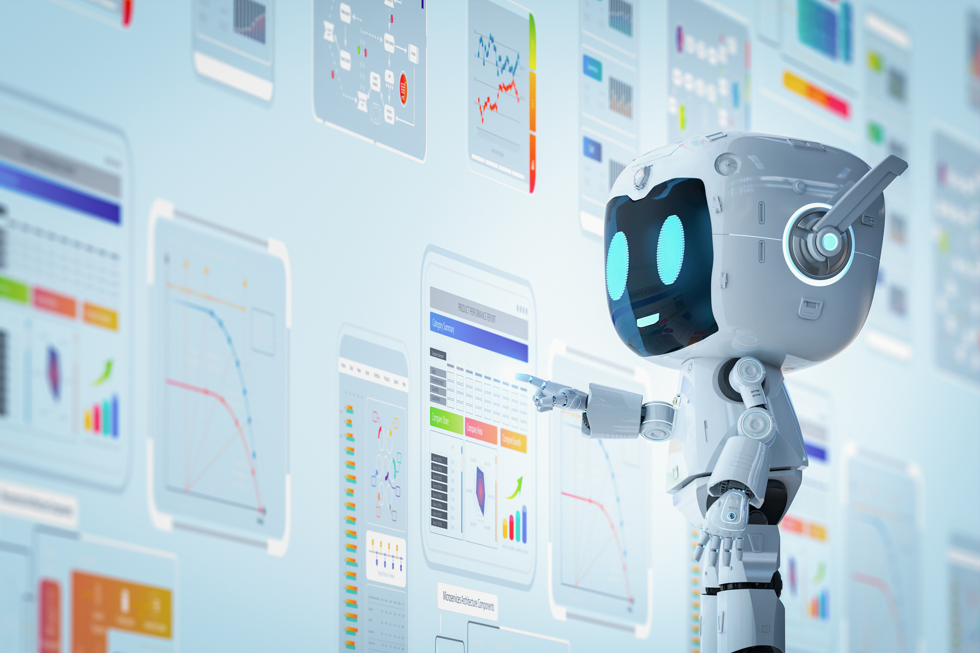
AREA OVERVIEW
🎯 Area: AI for Student Career Guidance & Future Planning
💡 Focus: Helping students make informed career decisions
🤖 Approach: Uses AI Time Visualization to simulate future self
📊 Goal: Provide personalized, data-driven guidance
IMPORTANCE OF AREA
⚡ Traditional counseling is outdated and generic.
🚀 Prepares students for exams and future careers effectively.
🎯 Students need personalized, motivating, and data-driven guidance.

Slide 3
ASPIRE AI
✨ Meet Your Future Self: Students interact with their future version for personal and inspiring career planning.
📝 Simple Input, Powerful Output: Enter age, habits, and goals; get a personalized future simulation.
❤ Emotional Guidance: Future-self conversations provide clarity, hope, and motivation.
🚀 Motivating Visuals: See future resumes, timelines, and inspiring letters to make dreams real.
🌟 Transforming Career Planning: Turns career planning into a journey of self-discovery and confidence.

Slide 4
Potential challenges & opportunities
🤕Student Challenges: Uncertainty, exam pressure, anxiety, and future confusion
📉 Traditional Counseling Limits: Generic, outdated, uninspiring, lacks motivation & strategies
⚡ The Gap: Lack of clarity prevents students from reaching full potential
🚀 The Opportunity: Aspire AI makes guidance engaging, personalized, and meaningful
🌟 The Impact: Aligns goals, habits, and trends to build clarity, confidence & future vision
📚 Future-Ready Education: Turns learning & exam prep into an inspiring, purpose-driven journey

Slide 5
Preliminary Solution Concept
🎯 Personalized Guidance: Tailored support for career, education & exams
📊 Smart Decisions: Maps goals & habits to clear pathways
📚 Exam Prep: Tracks progress & suggests strategies
⚡ Instant Support: Quick answers for academics & skills
🌟 Motivation: Future-self simulations to inspire action
✨ Aspire AI – your guide to clarity, motivation & future success.

Slide 6
Key Features and Functionalities
🤖 Future-Self Chatbot: Personalized guidance & motivation
⏳ Time Visualization: Letters, journals & life scenarios
📄 Future Resume: Predicts skills, achievements & milestones
🎯Timeline Roadmap: Academic & career progress tracker
📚 Exam Prep Tools: Smart study plans & milestone reminders
⏰ 24/7 Assistance: Instant answers for academics & skills
🌍 Multilingual Support: Accessible guidance in multiple languages
✨ Aspire AI – mentor, motivator & roadmap to success

Slide 7
Target Users and Expected Use Cases
👨‍🎓 Students: Explore careers, prep for JEE, NEET, UPSC, CAT, SSC, Banking & visualize future
👨‍🏫 Educators/Counselors: Offer personalized AI guidance for academics & exams
👨‍👩‍👧 Parents: Track progress, understand strengths & support career/exam choices
Typical Use Cases
👨‍🎓JEE Aspirant (Engineering Dreamer):
A 17-year-old asks: “Future me, did I crack JEE and get into IIT Bombay?”
👉 AI responds with their future self’s story of preparation, coaching, and campus life.
🏛 UPSC Aspirant (Civil Services):
A 22-year-old asks: “Future me, did I become an IAS officer?”
👉 AI responds with a journey of discipline, test series, interviews, and first posting as a District Collector.

Slide 8
Data Requirements and Privacy Considerations
🛡 Data & Privacy:
📌 Minimal Input: Only age, education, goals & interests
📌 Trusted Sources: Public datasets & exam trends
📌 No Permanent Storage: Real-time simulations; optional save
🔐 Privacy & Security:
🔐 Encryption: All interactions protected
✅ Consent First: Data saved only if student opts
☁ Secure Cloud: Easy deletion, encrypted storage
🛡 Compliance: Follows global data laws
⚡ Audits: Regular security checks

Slide 9
AI Technologies and Methods
🔤 NLP: Understands text/audio, summarizes & categorizes
🤖 Machine Learning: Learns patterns & predicts trends
📈 Data Analytics: Analyzes trends & generates insights
🖼 Computer Vision: Processes images/docs & organizes visuals
💾 Digital Preservation: Auto metadata, makes content searchable
⭐ Recommendation System: Curates & highlights meaningful content

Slide 10
Implementation Approach
📝 Planning (1–2 wks):
Define goals, gather requirements, check constraints
📂 Data Prep (2–4 wks):
Collect, clean & explore data
🤖 AI Prototype (3–6 wks): Build, test & iterate models
⚡ Optimization (2–4 wks): Tune, validate & check bias
🌐 Deployment (3–5 wks): Integrate, scale & monitor
📊 Continuous Improvement:
Track, retrain & refine with feedback

Slide 11
Evaluation Metrics
✨ Interactive: Fun, personalized AI messages
🧠 Learning: Track growth, goals & habits
⏱ Efficiency: Saves time for admins
💖 Retention: Encourages repeat visits
key Metrics / KPIs:
⚙ Technical:
⏱ Response < 2s
🖥 Uptime ≥ 99%
✅ Accuracy ≥ 85%
📊 Engagement:
👥 Active ≥ 70%
⏳ Session ≥ 5 min
📝 Prompts ≥ 60%
💡 User Satisfaction:
⭐ Score ≥ 4/5
🔄 Retention ≥ 50%
😊 Positive ≥ 80%

Slide 12
Why This Matters: The Power of Future VISION
😌 Beat Exam Stress → Talk to your future self & stay motivated
🎮 Make Learning Fun → Gamified plans, leaderboards & progress tracking
🤖 Smarter Prep, Better Scores → AI Study Buddy adapts plans & fixes weak spots
🎯 Stay Goal-Focused → Future-self reminders keep ambition alive
🌱 Build Life-Long Resilience → Confidence, persistence & emotional strength
📈 Track Progress Easily → Visual dashboards to monitor growth & milestones
🤝 Be Part of a Community → Study groups, peer challenges & shared success
🧠 Boost Focus & Discipline → AI nudges & smart schedules keep you on track
🔄 Personalized Learning Paths → Dynamic plans tailored to your pace & needs
🚀 Turn Dreams into Reality → Bridge ambition with actionable strategies

